Slide 1
Admission Agent
IBM HACKATHON PROJECT
Presented By:
Student name : Mohanavel A
College Name & Department : K.S.Rangasamy College of Technology
& Computer Science and Engineering

Slide 2
OUTLINE
Problem Statement
Technology used
Wow factor
End users
Result
Conclusion
Git-hub Link
Future scope
IBM Certifications

Slide 3
Problem Statement
Students and parents often face confusion during the college admission process due to scattered information, inconsistent eligibility criteria, dynamic cut-off trends, and lack of personalized guidance. Despite the availability of brochures, websites, and helpdesks, manually browsing multiple sources for updated information is time-consuming, inefficient, and error-prone.
Proposed Solution: The Admission Agent is an AI chatbot that uses NLP and RAG (Retrieval-Augmented Generation) to provide instant, accurate answers to admission-related queries. Built with IBM Watson Assistant and Granite models, it helps users find relevant information from brochures, cutoff lists, and documents—making the admission process faster, easier, and more accessible.

Slide 4
Technology used
IBM cloud lite services
Natural Language Processing (NLP)
Retrieval Augmented Generation (RAG)
IBM Granite model

Slide 5
IBM cloud services used
IBM Cloud Watsonx AI Studio
IBM Cloud Watsonx AI runtime
IBM Cloud Agent Lab
IBM Granite foundation model

Slide 6
Wow factors
✅ RAG-Powered Intelligence Combines Retrieval-Augmented Generation with Watson Assistant to generate context-aware responses from real admission documents like PDFs and brochures.
🧠 Powered by IBM Granite Model
Uses IBM’s cutting-edge Granite-13B model for deep language understanding and reliable answer generation.
📄 Multi-Document Search
Handles multiple files (e.g., cutoffs, fee structures, program info) with contextual comprehension—no need for manual FAQs.
💬 Real-Time Chat Experience
Provides a 24/7 assistant interface for students to ask questions naturally—reducing institutional workload.
🌐 Deploy Anywhere
Can be easily embedded into websites or integrated via API into any college admission portal.
📊 Personalized, Relevant Replies
Understands user intent and fetches precise answers—no more searching through long PDFs or confusing websites.
🔒 Scalable & Secure on IBM Cloud
Built on IBM Cloud with enterprise-grade reliability and scalability.

Slide 7
End users
Academic Researchers
Research Institutions and Universities
Students
Educators

Slide 8
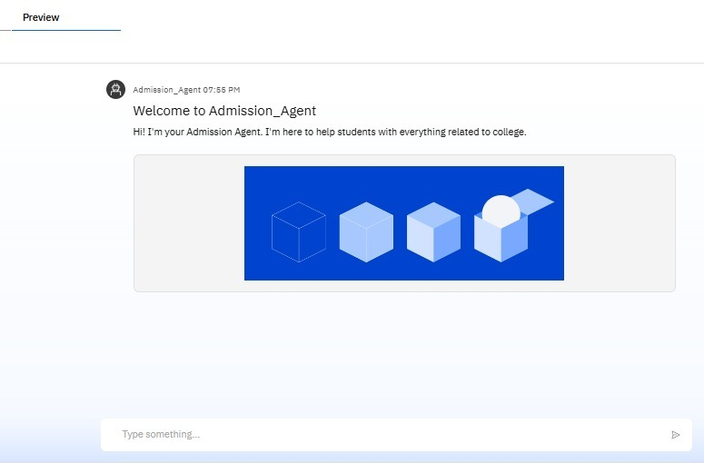
Results

Slide 9
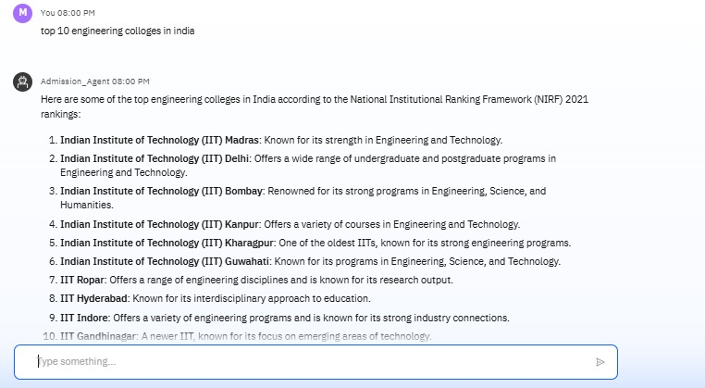
Results

Slide 10
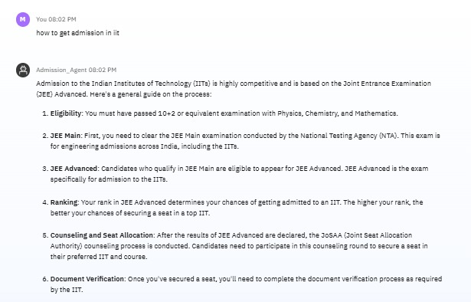
Results

Slide 11
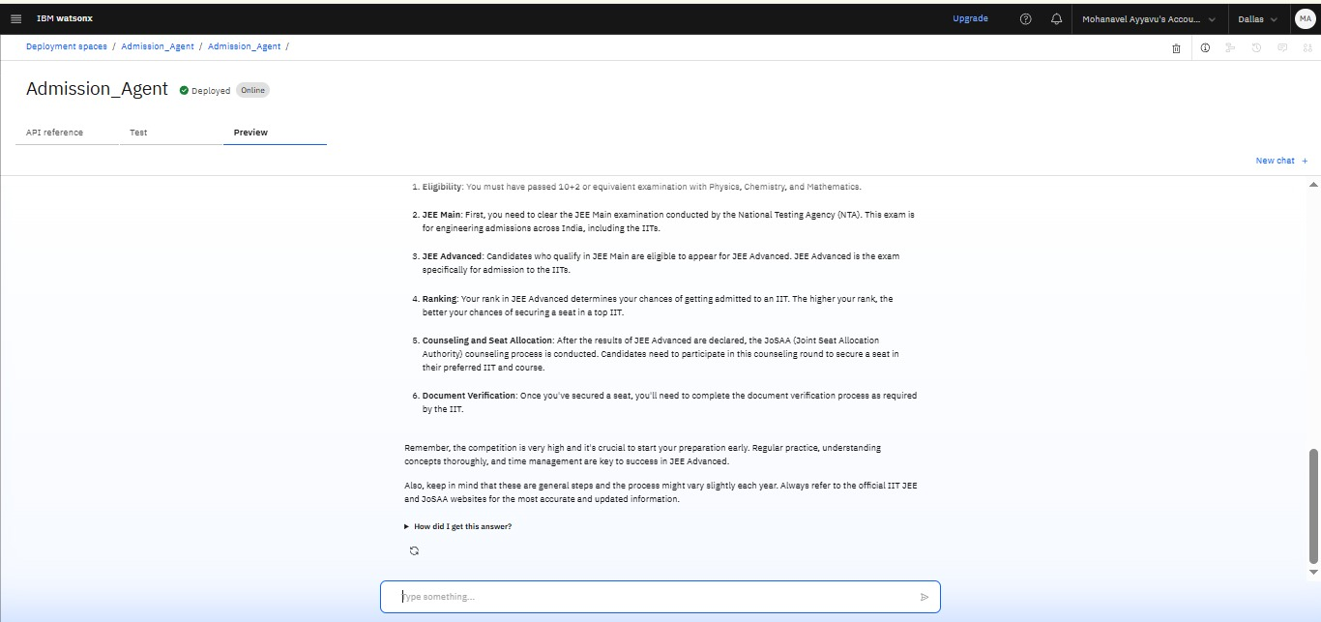
Results
Deployed AI Agent

Slide 12
Conclusion
The Admission Agent revolutionizes how students access admission information by providing a fast, intelligent, and interactive chatbot experience. By combining Natural Language Processing (NLP) with Retrieval-Augmented Generation (RAG) and powerful models like IBM Granite, it transforms static documents into dynamic, searchable knowledge. Whether it’s understanding eligibility, checking cutoffs, or navigating the application process, this assistant ensures that every query is answered accurately and instantly—making college admissions more transparent, accessible, and efficient for all.

Slide 13
Future scope
Add multilingual support for wider accessibility.
Enable voice-based interaction for hands-free use.
Develop a mobile app version of the agent.
Provide personalized course and college suggestions.
Integrate with college portals for real-time updates.
Include calendar reminders for key admission dates.
Offer admin dashboard with user analytics.

Slide 14
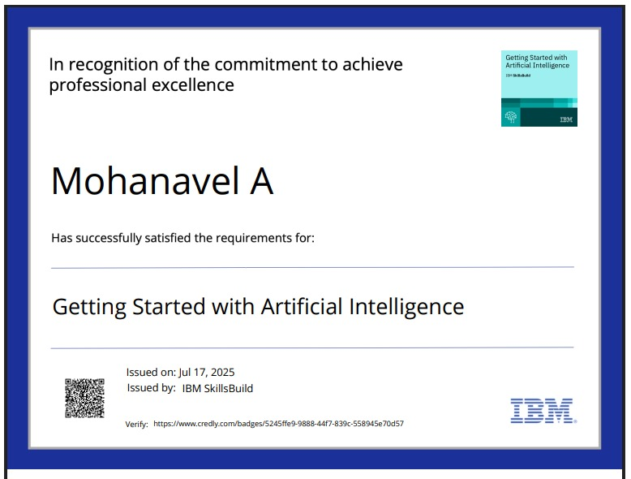
IBM Certifications

Slide 15
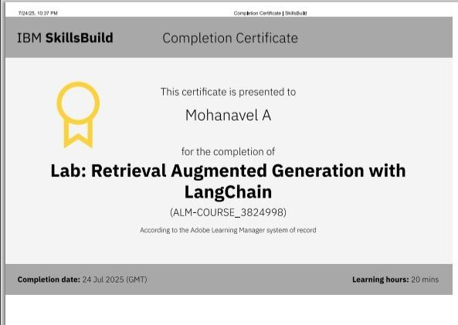

Slide 16
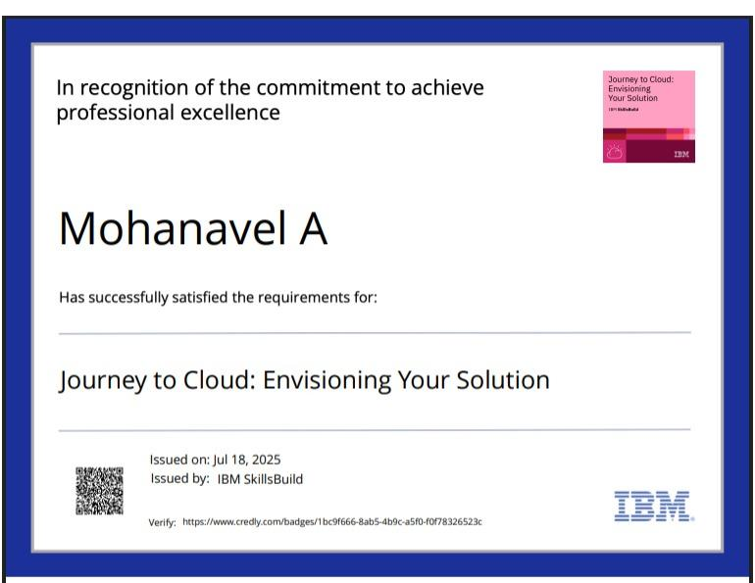

Slide 17
GitHub Link
https://github.com/Mohanavelayyavu/Admission_agent

Slide 18
THANK YOU

